Slide 1
You can make an app
Jeremy Lau
Notes:
Good afternoon everyone! Today I am going to share with you my journey of creating a desktop application from start to finish. I’ll also give you tips and advice on how to start building your own app.

Slide 2


Notes:
Many people think that they cannot make an app. You have to be a computer scientist, right? The truth is that you too can make an app - I’ll show you how.

Slide 3

Notes:
Let’s begin with brainstorming. Come up with an idea for an app you want to make, and look at examples of similar existing apps for inspiration.

Slide 4
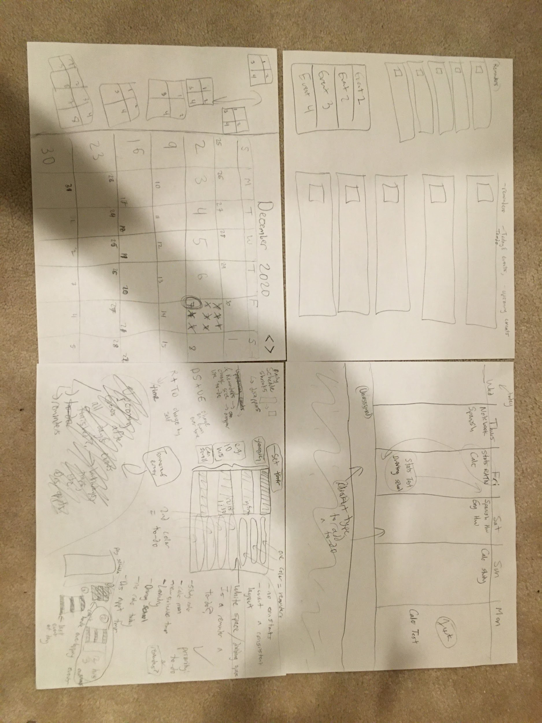
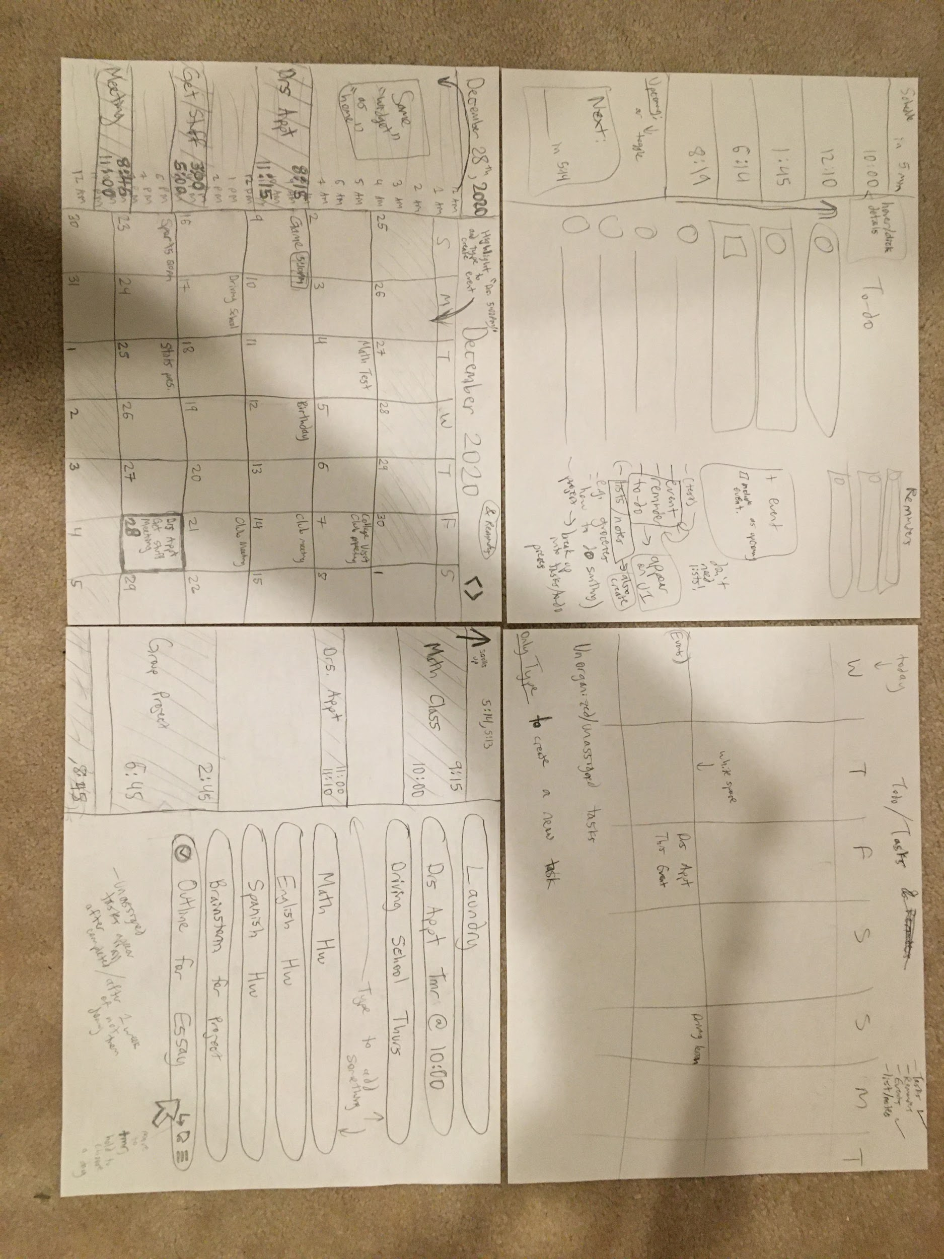
Notes:
In my case, I wanted to make a schedule slash todo app so I looked at Apple calendar, Microsoft todo, and other apps for inspiration when I was brainstorming.

Slide 5
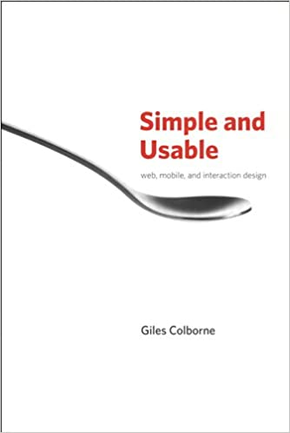
Notes:
Next, let’s simplify your app to its core functionality instead of filling it with unnecessary and time consuming features. A book that helped me to understand how to do this was Simple and Usable by Giles Colborne. Using the four techniques in the book including removing, hiding, organizing and displacing features, you will start to refine your design.

Slide 6
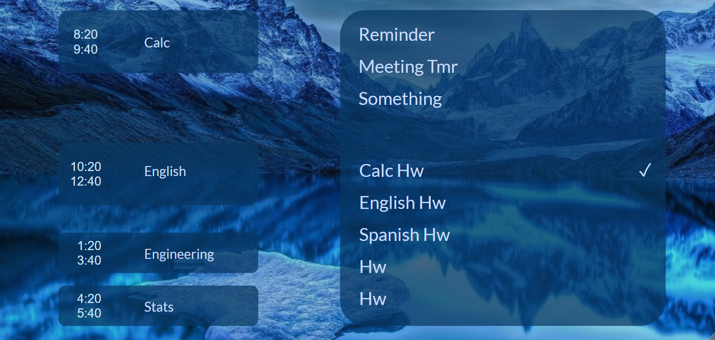
Notes:
Now you have a drawing on paper of your design, but let’s get an idea of what it might look like on a screen. I used Google Drawings to add images, shapes, and text to make a drawing of what I wanted to create.

Slide 7
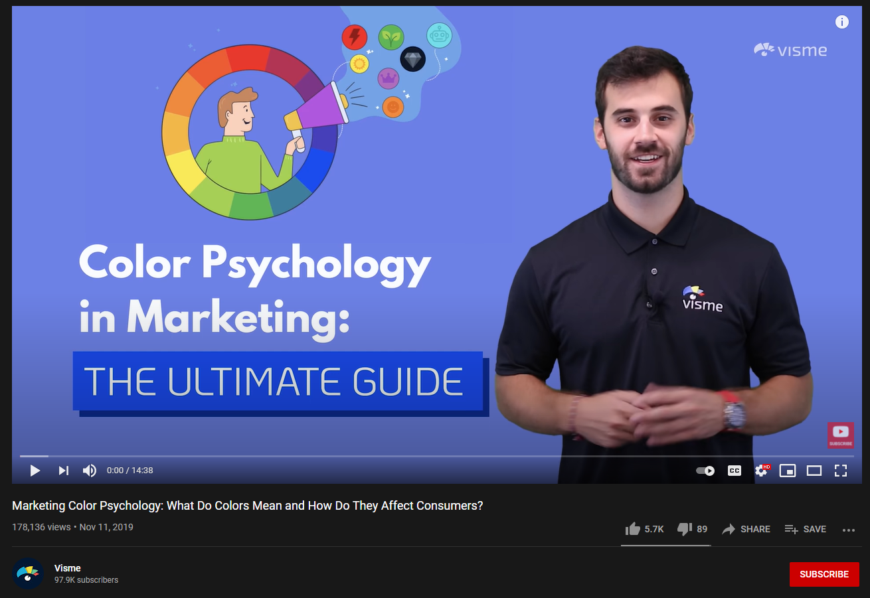
Notes:
While creating the design, I found some useful tips on how to use color by watching YouTube videos on color psychology. For my purposes, I used cool colors including many hues of blue to make the user feel calm and relaxed when looking at their busy day.

Slide 8


Notes:
Great! You have a good idea of what you want the app to look like. Now it's time to build it. I wanted to make a Windows desktop app, so I recommend using Visual Studio to create your app. There are many free resources available on Microsoft’s website including walkthroughs of projects to help you get started on your own projects.

Slide 9
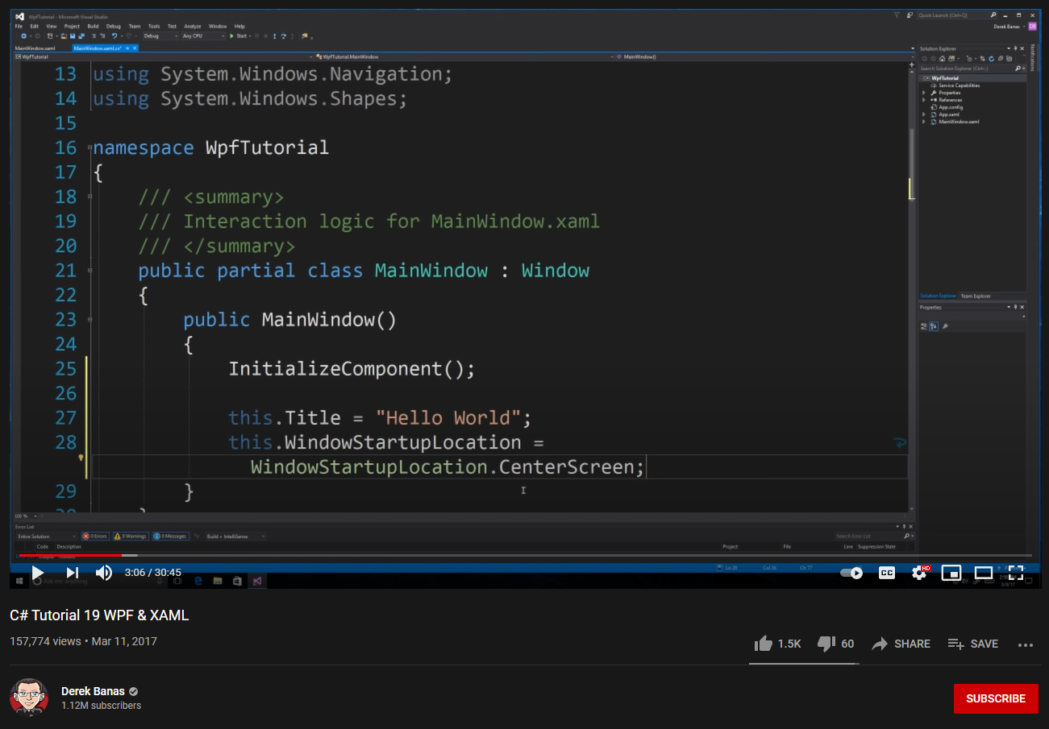
Notes:
At first, the displays seem intimidating, but after watching a series of YouTube tutorials, you can figure out how each part of the software works and start to write your own code, even if you haven’t written code before.

Slide 10





Notes:
As always, if you ever run into any problems, Google is your best friend. When you Google the error messages, chances are that someone asked the same question on Quora, StackOverflow, or Reddit. YouTube also has great tutorials on many topics you will encounter. If one website does not have any answers, keep looking and you will eventually find a solution on another website.

Slide 11
Notes:
So, if you remember - this is the Google drawing of what I wanted my app to look like. Let’s take a look at what my finished working app looks like.

Slide 12
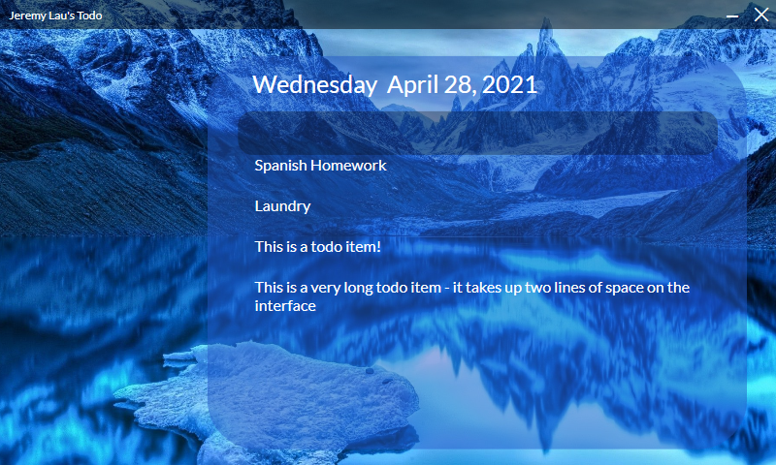
Notes:
Yooo! This is my finished todo app that I created for my project. You can add your own items to the todolist, and it closely matches my design that I had in mind for the app. I even created my own date and time display that mimics the Apple Calendar display.

Slide 13
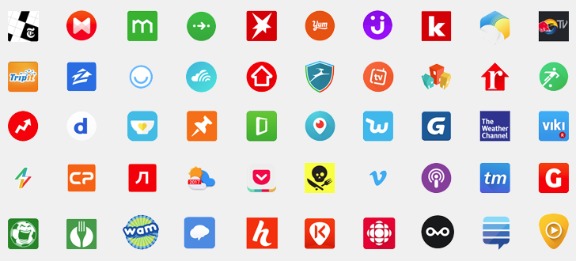
Notes:
You can create a todo list, a fitness tracker, or even an app for your business.
The truth about making an app is that it boils down to four simple steps: coming up with an idea, simplifying it, drawing it, and building it. YouTube and Google are your best friends if you ever run into problems or want to learn more about a topic.
What will you create?
Thank you.

